Slide 1
Banking Data Mining Case Study
João Pedro Dias – ei11137
Jorge Santos – ei11057

Slide 2

CRISP-DM

Slide 3
Business & Data Understanding
Business is based of operations in any regular bank such as transactions, clients, credit cards and loans.
Analysis of data tables relationships
Understanding the attribute’s “names” and their meaning
Understanding the attribute’s content meaning (possible values of each attribute like the range and type)
Notes:
Explain that the data we got is about typical operations in a bank and additional demographic generic data.
Relationships between tables (relations knowledge)
Get to know our mining objective – loans success prediction
Excel.

Slide 4
Data Preparation
Renaming attribute’s names for more meaningful keywords.
Spreadsheet “Demographic Data”
Extract implicit knowledge
Extract “birthdate” and “sex” from clients birth number
Extract client age from birth number
Eliminate incoherence provoked by empty files
District D69 had missing values that were replace by average value of all other districts
Retrieve useful information from “transaction” datasheet.
Ex.: Accounts with history of sanctions.
Notes:
Manual steps.
Normalization and discretization (rapidminer joins) techniques were used in final steps of preparation phase.
Excel / Rapidminer

Slide 5
Descriptive data analysis
Notes:
EDA – exploratory data analysis using charts and statistical rules
Clustering and association rules.
Rapidminer and Excel

Slide 6
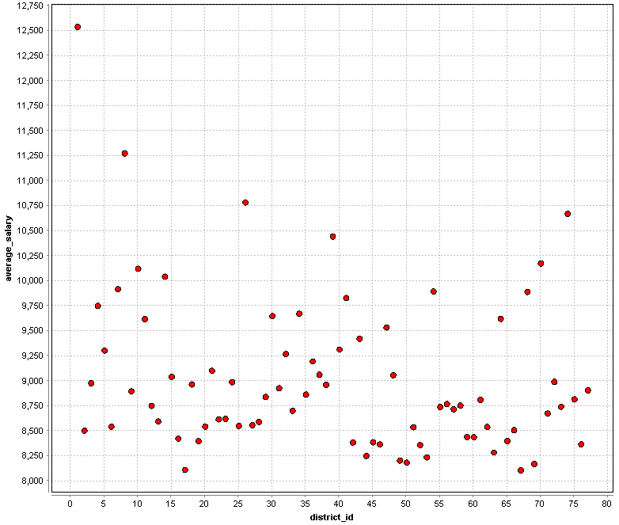
Salary data distribution
Data shows a large variance of average salary by district.
Notes:
This is good for data mining proposes since we got a good distribution (no bias). An we can see that different districts have normally different salaries associated.

Slide 7
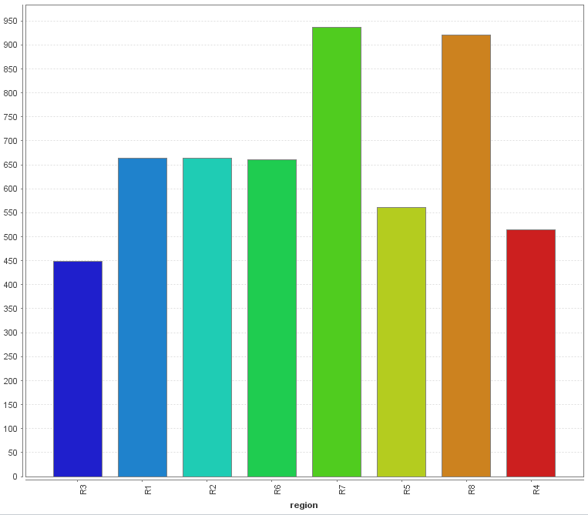
Number of clients per region
Data seams equal distributed by region.
Notes:
Once again we got no bias, with an similar population rate between all regions.

Slide 8
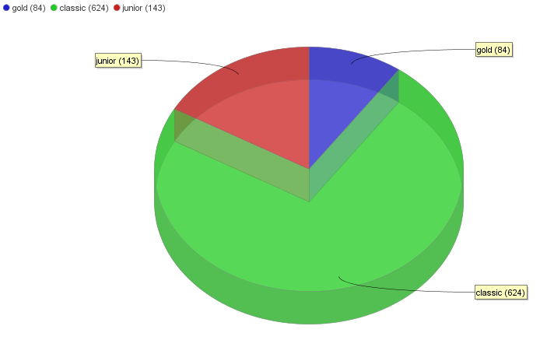
Card Type distribution
We see a big presence of cards of the type “classic” with a smaller presence of “junior” followed by “gold” cards.
Notes:
We see a pattern that credit cards are typical classic. Gold and junior cards are less common, since the conditions of this cards depends on specific client characteristics (age, Client Lifetime Value).

Slide 9
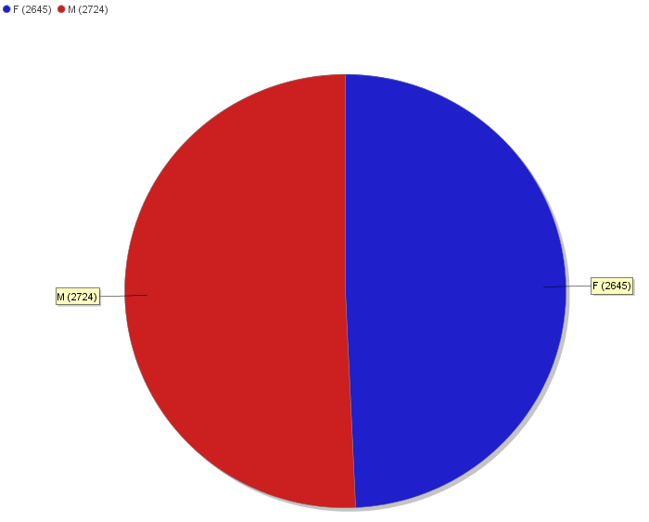
Clients gender distribution
Data seems equally distributed between genders, so seems there is no bias on gender.
Notes:
But we got to consider that this includes Owners and dispones.

Slide 10
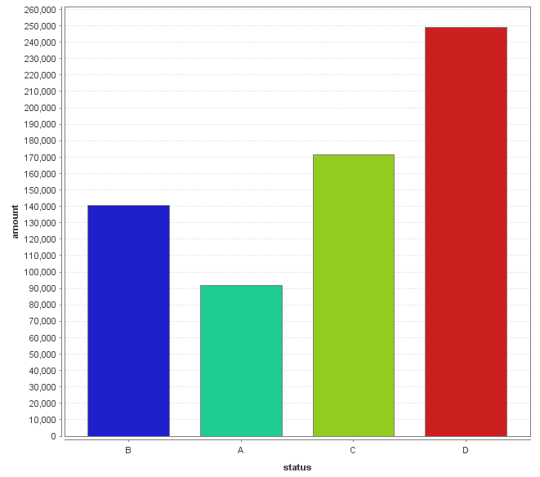
Loan amount distribution by status
We see a pattern that loans with larger amounts tend to be more risky with clients staying with debts (type B). On the other hand, clients with smaller loans tend to finish all the loans without problems (type A).
On running contracts, we see that larger loans tend to be more suitable indebting clients (type D).
Notes:
This get us an overview of all clients with loans, as well the success rates. Based on this data we can see if there are lots of success or insuccess what can be useful to the bank (adjust campaigns/conditions)

Slide 11
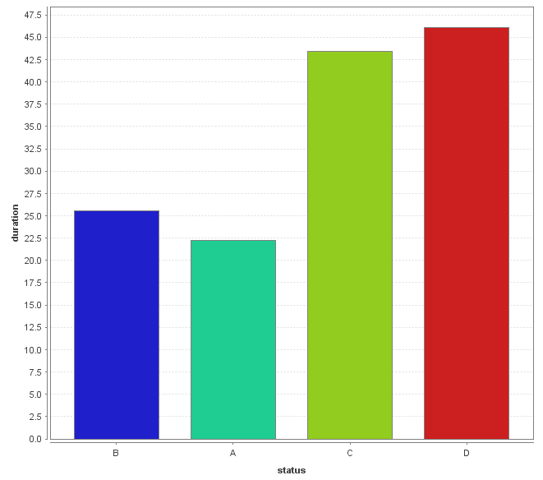
Loan duration distribution by status
We see a pattern that loans with longer durations tend to be more risky with clients staying with debts (type B). On the other hand, clients with smaller contract durations tend to finish all the loans without problems (type A).
On running contracts, we see that longer duration loans tend to be more suitable for indebting the clients (type D).

Slide 12
Clusters
We took on several data tables that’s seems to have useful data for creating clusters of clients in a way that the bank can target any of these clients with specific campaigns (for example marketing).
Notes:
At a technical/data mining level we got some problems regarding dimensionality of the data, noise (not useful data) and irrelevant attributes.
Good distribution of the data (variety, quantity) give us better and precise classification.

Slide 13
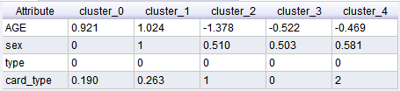
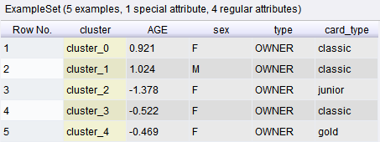
Client / Card Type Clusters
Cluster Model
From analyzing the relations between client details and credit cards existent we found out that there is a pattern between gold card types and a relative younger that the average age.
As expected we found a relation between young age and junior credit card type.
Additionally we found a group of classic credit card owners predominantly defined by the male gender and older age.
Example Set (Extract Cluster Prototypes)
Operator: K-means
Clusters: 5
Max runs: 20

Slide 14
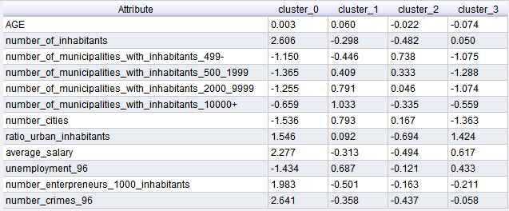
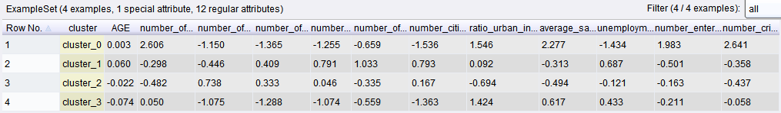
Client / Demographic clustering
Cluster Model
Operator: k-means
Clusters: 4
Max runs: 20
In this case we see a set of patterns in the groups. First we got a correlation between the number of crimes and the population ratio, which is represented in a lower number of cities that are more densely populated.
Also, we noticed that lower average salaries is associated with a more dispersed population, with less number of cities.
Example Set (Extract Cluster Prototypes)

Slide 15
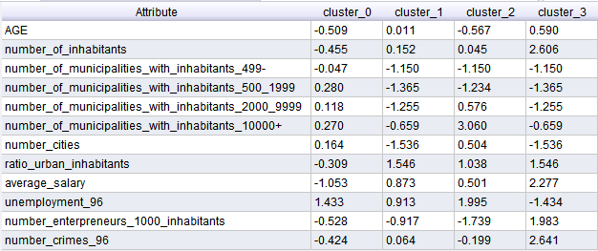
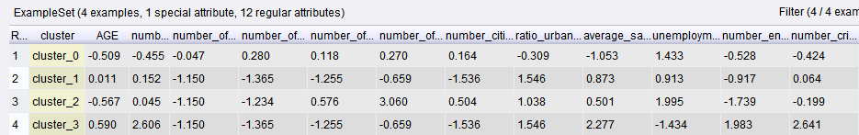
Client / Demographic clustering
Cluster Model
Operator: k-medoids
Clusters: 4
Max runs: 5
Max optimizations: 50
In order to validate the results by the k-means algorithm on the analysis of the “Client / Demographic clustering” we used k-medoids algorithm and we reached the same results but we noticed that, besides all the optimizations, this is a really slower process, which get worse with larger datasets.
Example Set (Extract Cluster Prototypes)

Slide 16
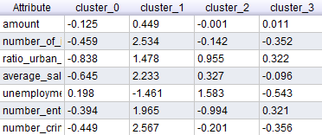
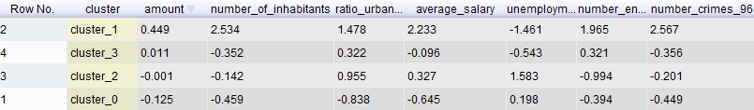
Client / Demographic / Insurances clustering
Cluster Model
Operator: k-means
Clusters: 4
Max runs: 10
In this approach we tried to found a relation between the data provided by the spreadsheets client, demographic and transactions (insurance payments) and we found out that clients in districts with higher number of crimes and high number of entrepreneurs have transactions with higher amount related with insurance payments.
Example Set (Extract Cluster Prototypes)

Slide 17
Predictive data mining
Notes:
RAPIDMINER all the way.

Slide 18
Data problems and applied solutions
We had a small dataset of finished loans
Around 234 finished loans (loans with status A or B)
Around 448 active loans (loans with status C or D)
Recurrent overfitting the model.
Modification of (pre)pruning parameters.
Ignoring of irrelevant attributes.
We opted for not using any date related field because that would make the model unsuitable for future predictions.
We opted to not use gender as a decision variable too.
There isn’t a good distribution of loans by status.
The majority of the current loans are of type C and finished loans of type A, difficulting the prediction of bad indicators for loans.

Slide 19
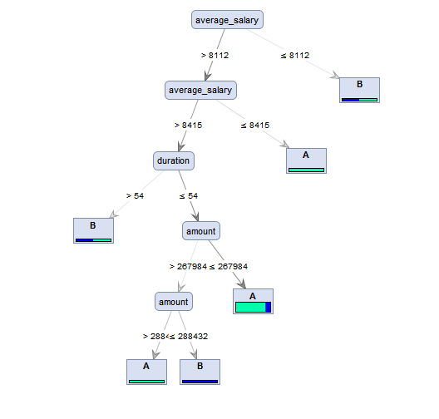
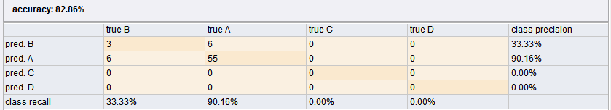
Decision tree for predicting successful loans based on finished loans only
We come to the conclusion that the most influencing attributes for loans success or failure are “average salary” of clients demographic data, “duration” and “amount” of the loans.
But in general this is a unsatisfactory result with really low precision.
Notes:
Decision support model at the business side, such as specific condition accordingly to the tree tests.

Slide 20
How we reach this solution?
Rapidminer
Using split validation operation:
70% as training data and 30% as testing.
Using Decision tree operator:
Using pruning:
Confidence 25%
Using pre-pruning:
Minimal gain of 5%
Use of data tables:
Clients, Account, Loans, Demographic
Analysis
Besides of the unsatisfactory results, we tried k-NearestNeighbour and Naïve Bayes and there were even worse results.
Notes:
Hold-out method was used to experiment this validation technique, and also, besides the standard values being 70/30, we see that this values were a good choice due to the variability of the given data, resulting in a better modelling.

Slide 21
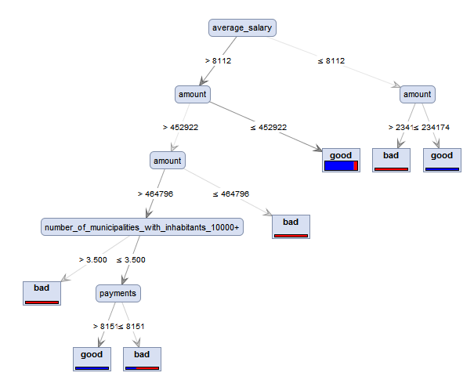
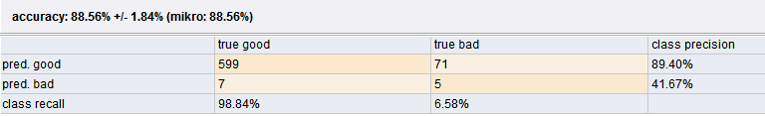
Decision tree for predicting successful loans based on finished and active loans
We come to the conclusion that the most influencing attributes for loans success or failure are “average salary”, “number of municipalities with inhabitants above 10000” of clients demographic data, “payments” and “amount” of the loans.
Notes:
Decision support model at the business side, such as specific condition accordingly to the tree tests.

Slide 22
How we reach this solution?
Rapidminer
Using x-validation operation:
Number of validations: 10
Using Decision tree operator:
Using pruning:
Confidence 25%
Using pre-pruning:
Minimal gain of 4%
Use of data tables:
Clients, Account, Loans, Demographic
Notes:
There was tries with different k number of validations, but in order to be more sure of the results of validation we decided to use 10 as the last verification value, since the relative % stabilized with this number.

Slide 23
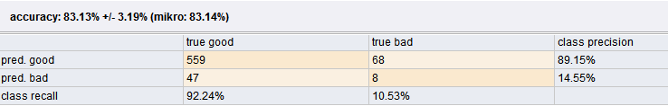
K-NearestNeighbor for predicting successful loans based on finished and active loans
KNNClassification
1-Nearest Neighbour model for classification.
The model contains 682 examples with 19 dimensions of the following classes:
good
bad
We get worse results with k-NearestNeighbor in relation to the same data in the decision tree. This is due to the k-NearestNeighbor way of analyzing each case attributes and taking in account each attribute for each new example added. In general this algorithm performs badly in data with high dimensions.

Slide 24
How we reach this solution?
Rapidminer
Using x-validation operation:
Number of validations: 10
Using k-NearestNeighbour operator:
k: 1
Measure Types: MixedMeasures
Use of data tables:
Clients, Account, Loans, Demographic
Notes:
There was tries with different k number of validations, but in order to be more sure of the results of validation we decided to use 10 as the last verification value, since the relative % stabilized with this number.

Slide 25
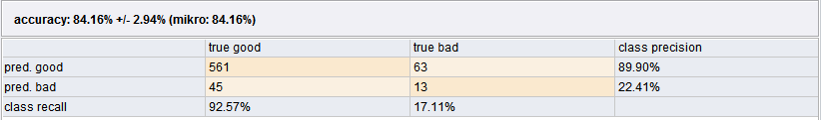
Naïve Bayes for predicting successful loans based on finished and active loans
SimpleDistribution
Distribution model for label attribute status-good-bad
Class good (0.889)
19 distributions
Class bad (0.111)
19 distributions
In this case, since naïve bayes algorithm takes each attribute as independent attribute we got simillar results to the k-NN. In relation to the decision tree we see that we got a little more of false negative rate.

Slide 26
How we reach this solution?
Rapidminer
Using x-validation operation:
Number of validations: 10
Using Naïve Bayes operator:
Laplace correction: true
Use of data tables:
Clients, Account, Loans, Demographic
Notes:
There was tries with different k number of validations, but in order to be more sure of the results of validation we decided to use 10 as the last verification value, since the relative % stabilized with this number.

Slide 27
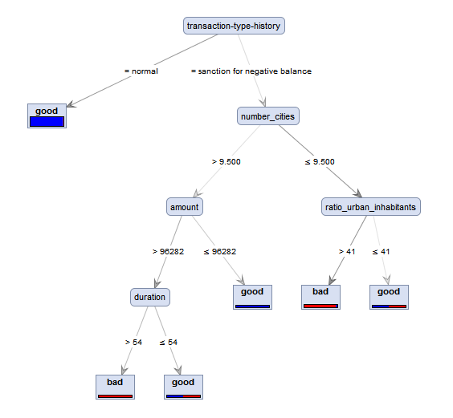
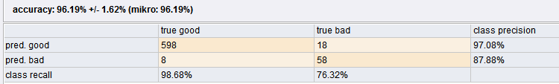
Decision tree for predicting successful loans based on finished and active loans and transaction data
We come to the conclusion that the most influencing attributes for loans success or failure are “number of cities”, “ratio of urban inhabitants” of clients demographic data, “duration” and “amount” of the loans and account transaction’s type history.
Notes:
Decision support model at the business side, such as specific condition accordingly to the tree tests.

Slide 28
How we reach this solution?
Rapidminer
Using x-validation operation:
Number of validations: 10
Using Decision tree operator:
Using pruning:
Confidence 25%
Using pre-pruning:
Minimal gain of 10%
Use of data tables:
Clients, Account, Loans, Demographic, Transactions
Notes:
There was tries with different k number of validations, but in order to be more sure of the results of validation we decided to use 10 as the last verification value, since the relative % stabilized with this number.

Slide 29
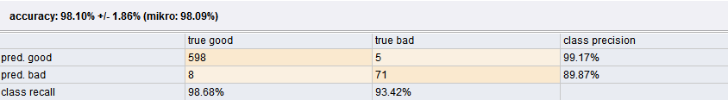
Support Vector Machine for predicting successful loans based on finished and active loans and transaction data
Kernel Model
Total number of Support Vectors: 682
Bias (offset): -1.013
Ex.Weights calculated:
w[transaction-type-history = sanction for negative balance] = 0.712
w[transaction-type-history = normal] = -0.093
w[number_of_municipalities_with_inhabitants_500_1999] = -0.001
Using SVM we got even better results that in decision tree for loans success.
This is because SVM is more robust to the curse of dimensionality.
Notes:
Decision support model at the business side, such as specific condition accordingly to the predicted results given on each test. (for example in new clients)

Slide 30
How we reach this solution?
Rapidminer
Using x-validation operation:
Number of validations: 10
Using SVM operator:
Kernel type: dot
Cache: 200
Convergence epsilon: 0.1%
Max iterations: 100000
Use of data tables:
Clients, Account, Loans, Demographic, Transactions
Notes:
There was tries with different k number of validations, but in order to be more sure of the results of validation we decided to use 10 as the last verification value, since the relative % stabilized with this number.

Slide 31
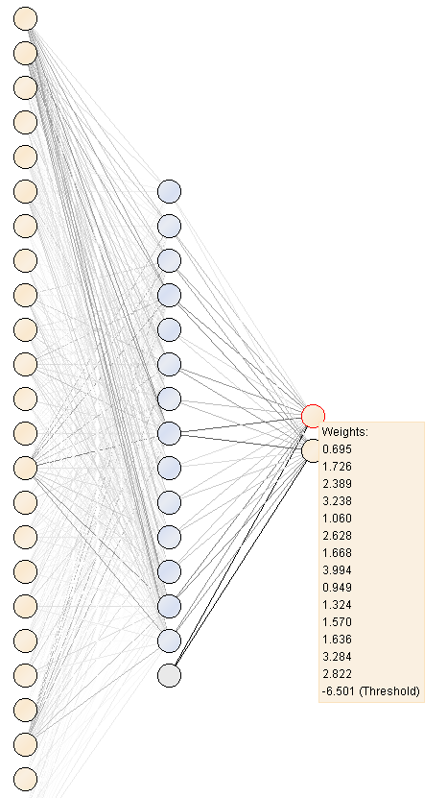
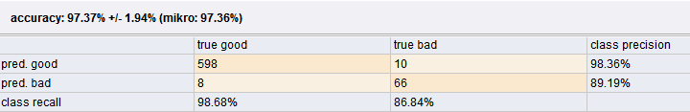
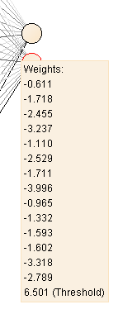
NeuralNet for predicting successful loans based on finished and active loans and transaction data
Using NeuralNet we got equivalent results to the supported vector machine.
This is because, like in the SVM, NeuralNet is more robust to the curse of dimensionality. On the other hand its really slow to train and difficult to understand the final weight values.
Notes:
Decision support model at the business side, such as specific condition accordingly to the predicted results given on each test. (for example in new clients)

Slide 32
How we reach this solution?
Rapidminer
Using x-validation operation:
Number of validations: 10
Using NeuralNet operator:
Trainning cycles: 500
Learning rate: 0.3
Momentum 0.2
Shuffle: true
Normalize: true
Use of data tables:
Clients, Account, Loans, Demographic, Transactions
Notes:
There was tries with different k number of validations, but in order to be more sure of the results of validation we decided to use 10 as the last verification value, since the relative % stabilized with this number.

Slide 33
Q & A
“If your model is too perfect, throw it away.” - Carlos Soares
Thanks!
Notes:
As conclusions:
Results obtained are generally good for taking data-driven decisions, but consider that this data is old, so the predictions very possibly are not useful today. -> Get new data, get a whole new version of DM and PM.
Maybe use association rules and regression techniques as a complement to the clusters in DM.
Refinement of the algorithms used with real market tests with small impact but enough to validate them.
Select the best of the results only, since some models that give similar results can be simply throw away. (3 trees saying the same is the same as one)
Try new methods and methodologies like ensemble methods for predicting.

Slide 34
Annexes
Processes and other relevant observations.

Slide 35
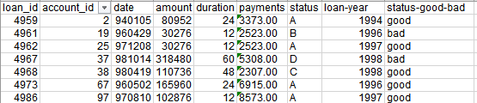
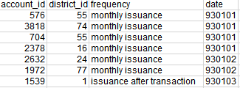
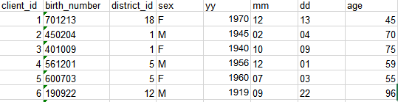

Data Preparation
Loans information
Account information
Client information
Account disposition information
Observation:
Data presentation on Excel after data understanding and transformation made by us.

Slide 36

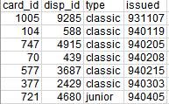
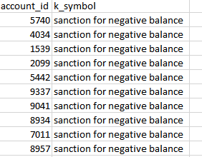
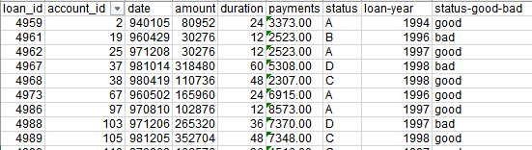
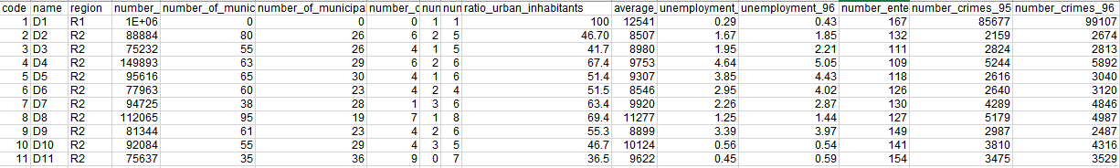
Data Preparation
Payment orders information
Credit card information and accounts with sanctions
Loans information
Demographic information
Observation:
Data presentation on Excel after data understanding and transformation made by us.

Slide 37
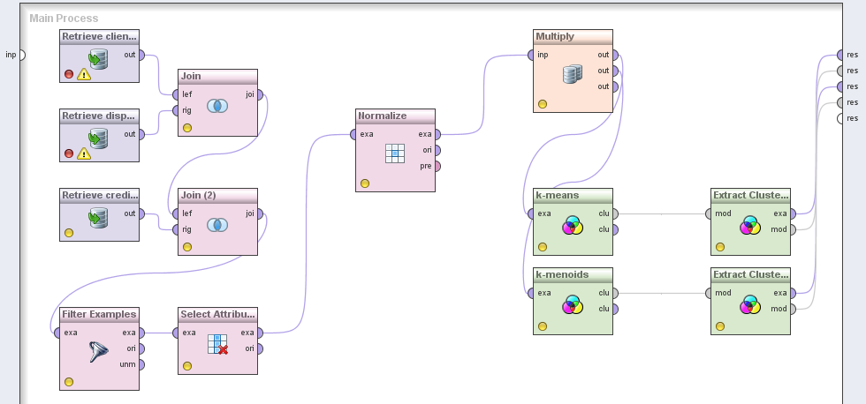
Clustering Client / Card Type
Observations:
Use of “Normalize” in order to avoid dominance of certain attributes due to the larger range of value.
Use of “Multiple” to be possible to use “K-means” and “K-medoids” at the same time.
“Select Attributes” operator was used to easily manipulate what attributes are used on the following operators.

Slide 38
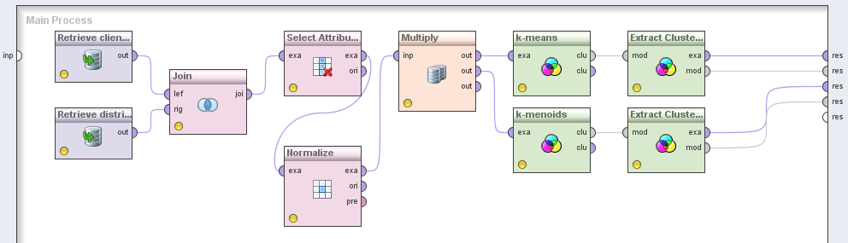
Client / Demographic clustering

Slide 39
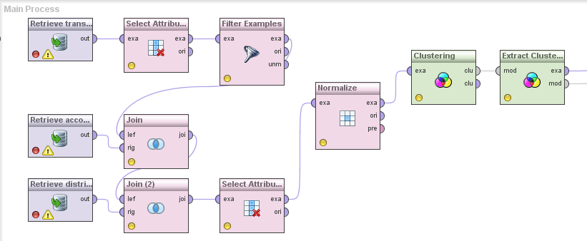
Client / Demographic / Insurances clustering

Slide 40
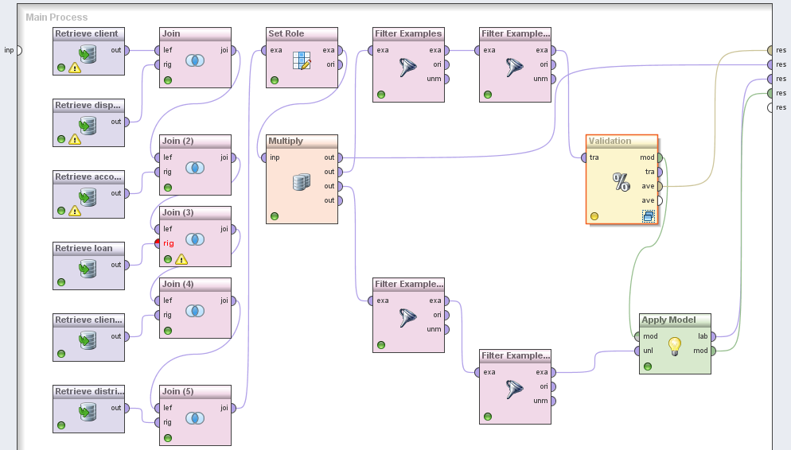
Decision tree for predicting successful loans based on finished loans only
Observations:
For simple verification of results obtained by the decision tree operator we took a challenge of matching the predicted “A” or “B” status against running loans (status “D” and “C”). We checked, as expected, that loans that are going well (status “C”) mostly ended successfully (status “A”) and vice-versa for status “B” that mostly end on status “D”. This is accomplished by using the “Apply Model” after the validation process.

Slide 41
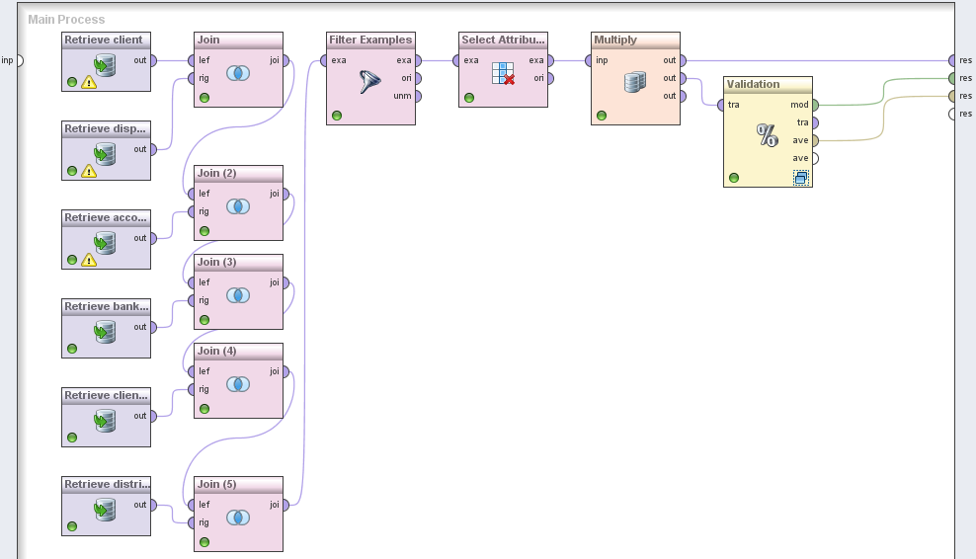
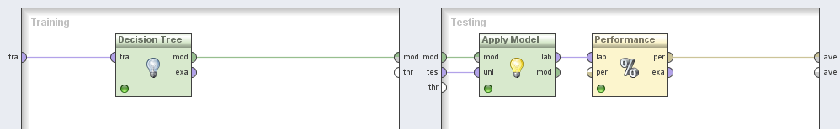
Decision tree for predicting successful loans based on finished and active loans

Slide 42
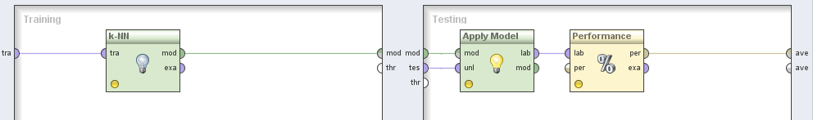
K-NearestNeighbor for predicting successful loans based on finished and active loans

Slide 43
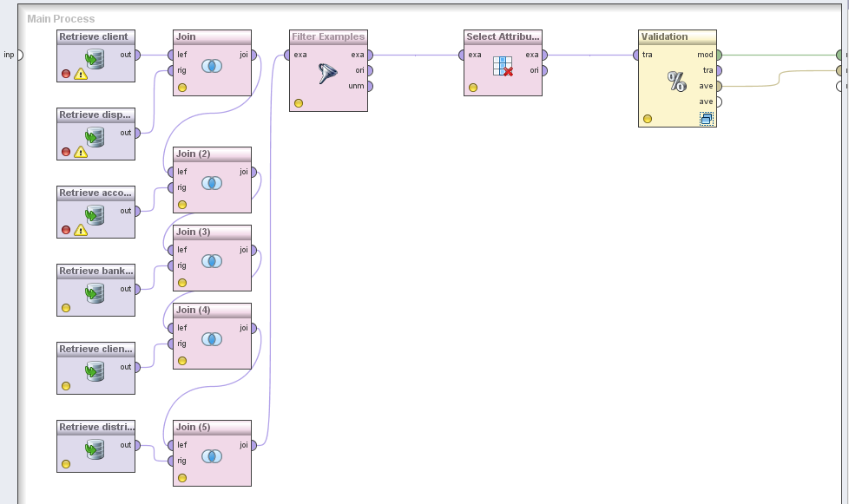
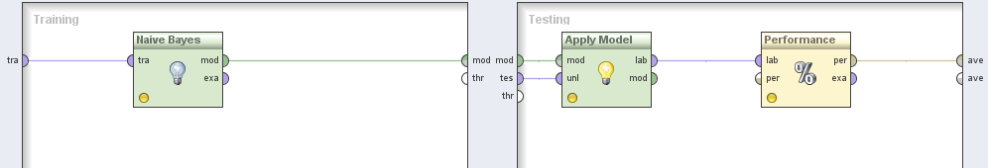
Naïve Bayes for predicting successful loans based on finished and active loans

Slide 44
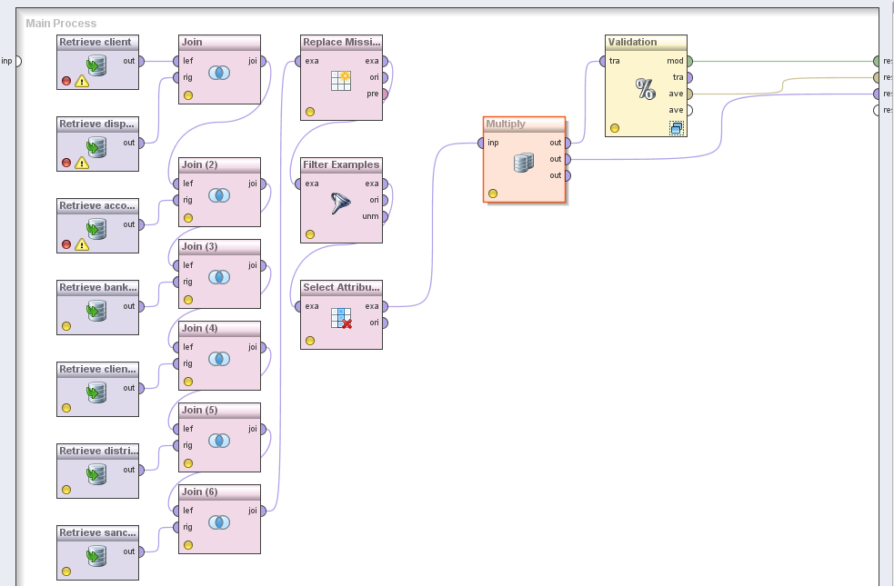
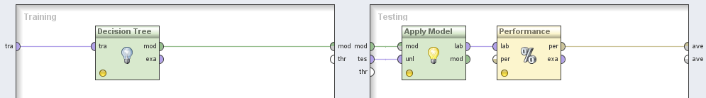
Decision tree for predicting successful loans based on finished and active loans and transaction data

Slide 45
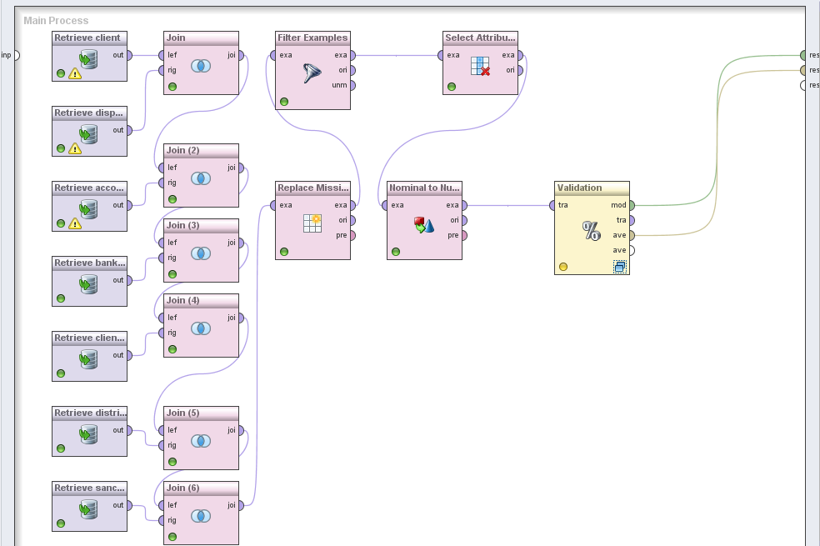
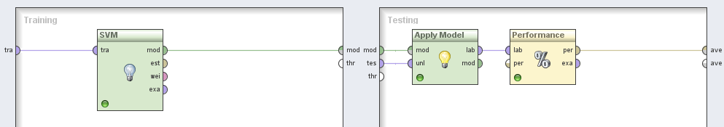
Support Vector Machine for predicting successful loans based on finished and active loans and transaction data
Observations:
Since “SVM” does not handle polynomial values we used “Nominal to Numeric” operator.

Slide 46
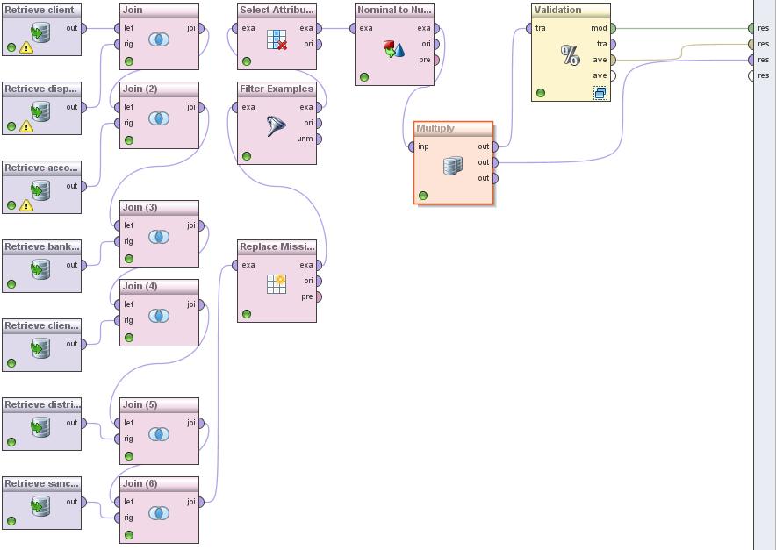
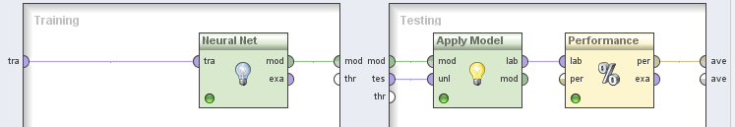
Neural Net Process
Observations:
Since NeuralNet does not handle polynomial values we used “Nominal to Numeric” operator.
Use of replacing missing values to give all accounts without any sanction the value “normal”
We used “Filter Examples” in order to leave only the client of type “OWNER”.

